Slide 1
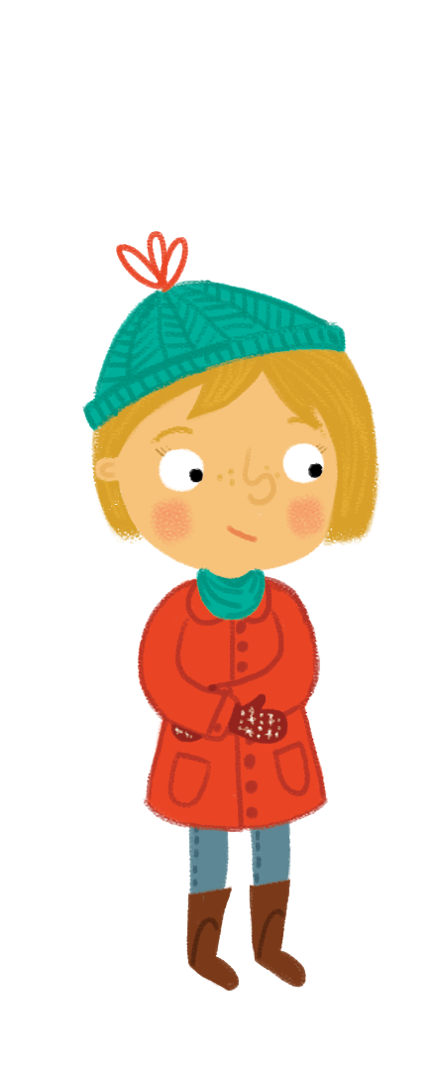

Tha i fuar an-diugh. Is toigh leam nuair a tha i fuar. Is toigh le mathan bàn nuair a tha i fuar cuideachd.
Notes:
It’s cold today. I like it when it’s cold. A polar bear likes it when it’s cold too.

Slide 2
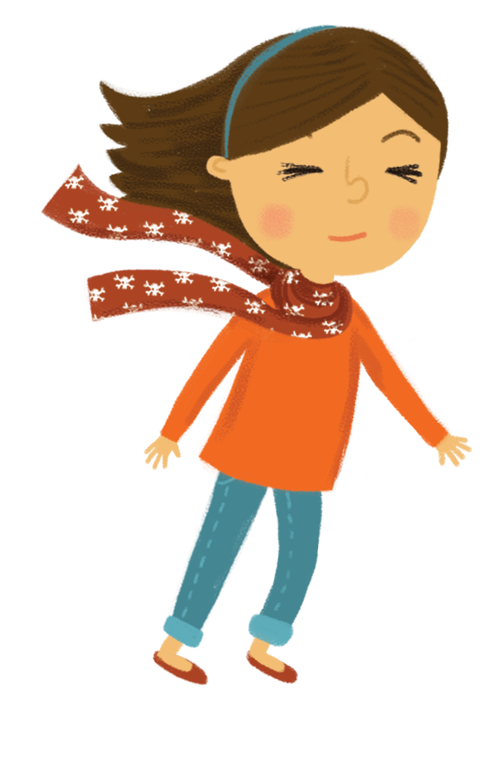
Tha i garbh an-diugh. Is toigh leam nuair a tha i garbh. Is toigh leis na duilleagan nuair a tha i garbh cuideachd.
Notes:
It’s windy today. I like it when it’s windy. The leaves like it when it’s windy too.

Slide 3

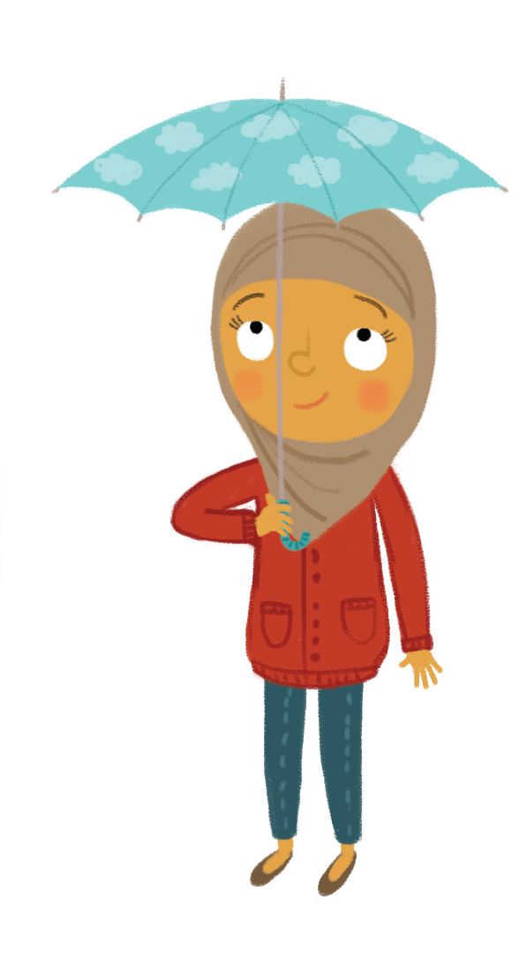
Tha i fliuch an-diugh. Is toigh leam nuair a tha i fliuch. Is toigh leis na tunnagan nuair a tha i fliuch cuideachd.
Notes:
It’s wet today. I like it when it’s wet. The ducks like it when it’s wet too.

Slide 4

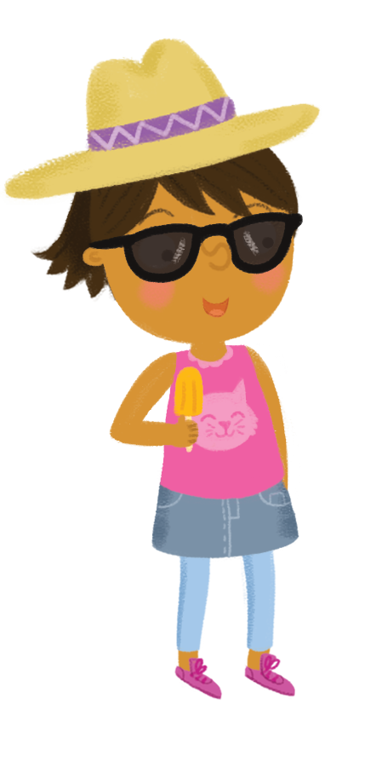

Tha i grianach an-diugh. Is toigh leam nuair a tha i grianach. Is toigh leis na flùraichean nuair a tha i grianach cuideachd.
Notes:
It’s sunny today. I like it when it’s sunny. The flowers like it when it’s sunny too.

Slide 5


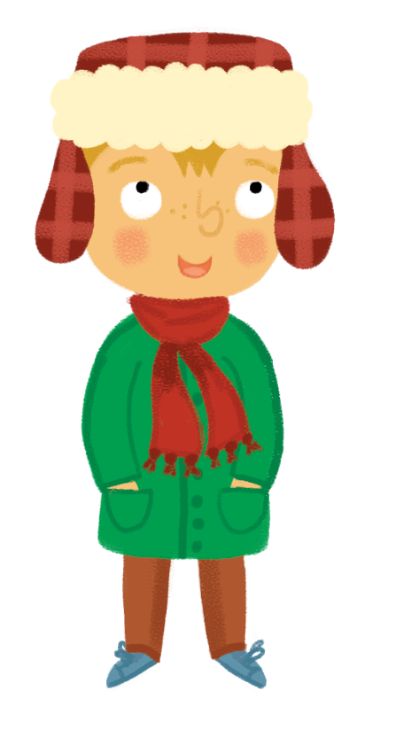
Tha sneachda ann an-diugh. Is toigh leam nuair a tha sneachda ann. Is toigh le bodach-sneachda nuair a tha sneachda ann cuideachd.
Notes:
There’s snow today. I like it when there’s snow. A snowman likes it when there’s snow too.

Slide 6
An toigh leat nuair a tha i fuar, no garbh, no fliuch no grianach? An toigh leat nuair a tha sneachda ann? Inns dhomh.
Notes:
Do you like it when it’s cold, or windy, or wet or sunny? Do you like it when there’s snow. Tell me.

